Slide 1
B2B Marketing Revenue Insights – iHeartMedia (Sample Analysis)
By: Iftekher Mamun
Dataset: 300k scrubbed rows
Tools: Python (EDA + AI assist in visuals/ analytics), tableau (dashboard)

Slide 2
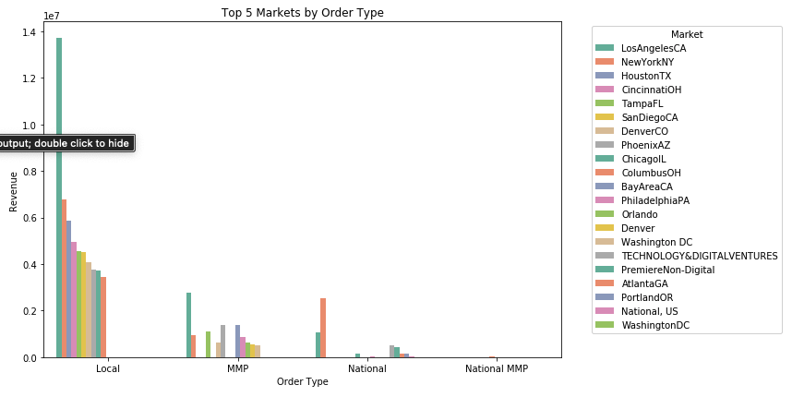
Market Performance
Top markets by revenue: Los Angeles, New York, Houston, Cincinnati OH
Bottom markets by revenue: LaGrange, Gallup NM, Defiance, New Haven CT
Focus more on higher performing markets

Slide 3
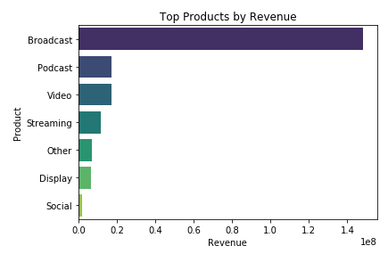
Product stand out
Broadcasting is the dominant driver, outpacing all other products
Podcast and streaming services have the potential to catch up
While maintaining broadcasting output, would recommend investing more resource in digital medias.
Social is least performing-
How is social different than podcast and other similar digital media

Slide 4
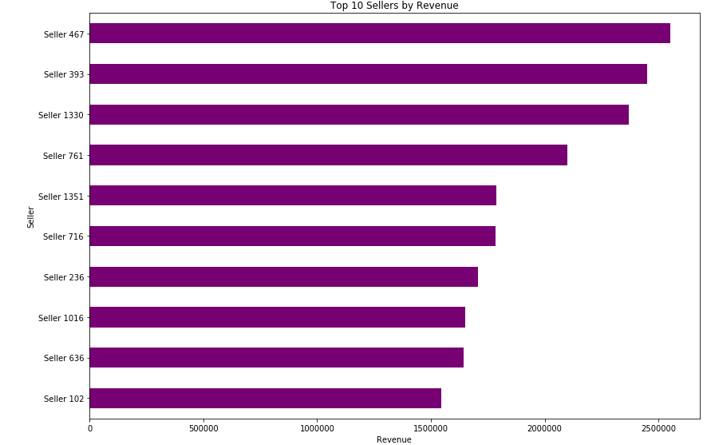
Seller stand out
Top sellers are Seller 467, followed closely by Seller 393 and 1330
Recommend increasing interaction and affiliation with these sellers
On Local the following sellers have only generated $1 in revenue: Sellers 1098, 1323, 169, 316 and 386
On MMP, the following sellers have only generated $1 in revenue: 1225, 1226,1320, 1374 and 1380
They may be performing better in other order type, but not in the top 5 or 10 for any category

Slide 5
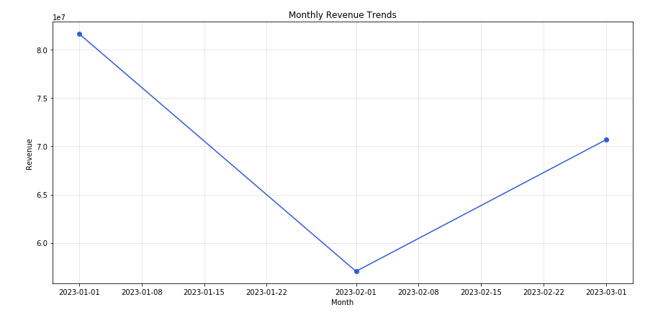
Seasonal Time trend
January high revenue is most likely due to the ending of the holiday season just days prior
February low revenue attributes to low seasonal activity which is reflected as market picks back up in March
Require more data to validate seasonal change

Slide 6
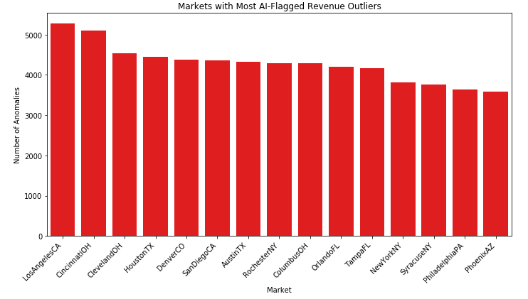
AI Assisted Insight
Isolation Forest flagged local market outliers with unusually high/low revenue (e.g., niche advertisers in small markets).
Outliers mostly align with Local order type → expected since local deals are smaller but spikier.
Why it matters: AI can automatically surface “hidden gems” or risk signals in the data, saving analyst time and ensuring sales leaders don’t overlook opportunities.
I do want to note that there is no direct relationship between outliers and bottom performing markets. Would recommend looking further in depth.

